Slide 1
Priority Queues
A priority queue is an ADT for storing (priority, data) pairs, where priorities are totally ordered (e.g., integers, strings, etc.)
Two variants (silly English):
low-magnitude priority means “high priority”
high-magnitude priority means “high priority”
#ifndef PQUEUE_H
#define PQUEUE_H
typedef void* PQEntry;
typedef void* PQueue;
int size(PQueue);
PQEntry insert(PQueue *pq, int priority, int data);
int deleteNext(PQueue pq, int *priority, int *data);
PQEntry update(PQueue pq, PQEntry e, int newPriority);
#endif

Slide 2
Priority Queue Implementations
Interview question: All n (priority, data) items known in advance, only need deleteNext. What is the best implementation?
AVL trees: pointer-based, large constant hidden in the O(.)
We will develop a fast, array-based implementation
size in O(1) time
insert and deleteNext in O(log n) time [smaller constant]
 | Linked List | Ordered Linked List | Ordered Binary Tree | Balanced Ordered Binary Tree
size | O(1) | O(1) | O(1) | O(1)
insert | O(1) | O(n)
deleteNext | O(n) | O(1)
update
O(n)
O(log n)
O(n)
O(log n)
O(1)
O(n)
O(n)
O(log n)

Slide 3
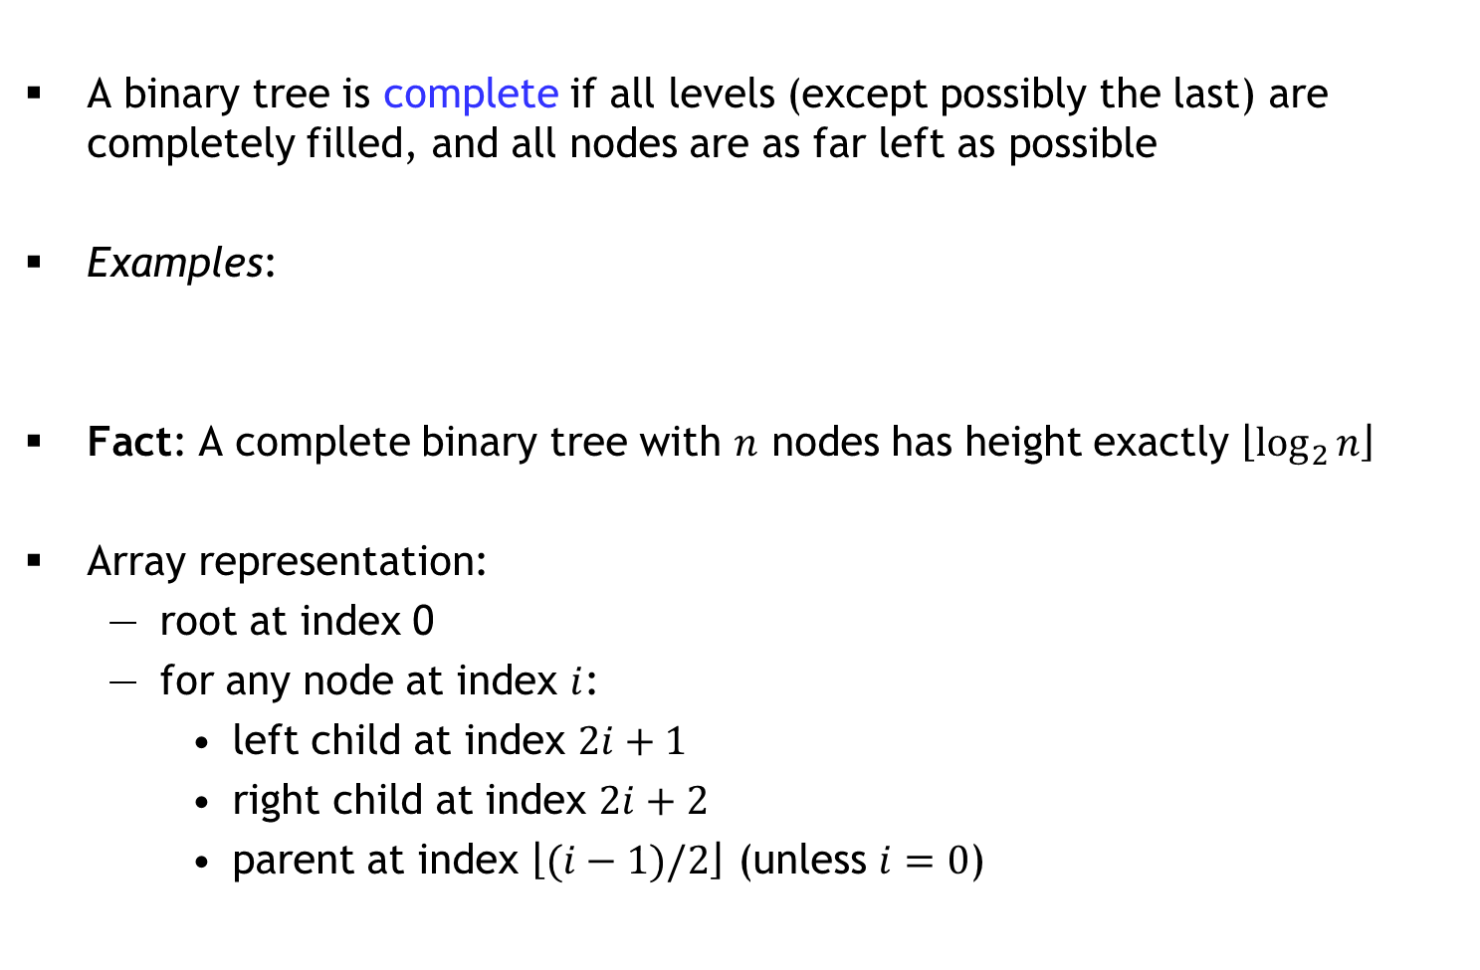
Complete Binary Trees
A binary tree is complete if all levels (except possibly the last) are completely filled, and all nodes are as far left as possible
Examples:
Fact: A complete binary tree with $n$ nodes has height exactly $\left\lfloor \log_{2}{n}\right\rfloor$
Array representation:
root at index 0
for any node at index $i$:
left child at index $2i+1$
right child at index $2i+2$
parent at index $\left\lfloor (i−1)/2\right\rfloor$ (unless $i=0$)

Slide 4
Heaps
Definition:
A minheap is a complete binary tree in which every node’s priority is less than or equal to the priority of its children (min. at root)
A maxheap is a complete binary tree in which every node’s priority is greater than or equal to the priority of its children (max. at root)
We implement a heap as an array
Question: Which of these arrays represent minheaps?
A
1 | 2 | 3 | 4 | 5 | 6
B
1 | 2 | 4 | 5 | 6 | 3
C
1 | 3 | 4 | 2 | 6 | 5
D
1 | 4 | 2 | 6 | 5 | 3

Slide 5
Sift Up
Suppose the heap is implemented as a struct with array a[] where each array is a struct with priority p and data d
void siftUp(Heap *H, int i) { // minheap
while(i > 0) {
int j = (i-1)/2; // parent
if(H->a[i].p >= H->a[j].p) { return; }
SWAP(H->a, i, j);
i = j;
}
}
What does siftUp(H, 3) do if H->a =
Insert = append to array + sift up the last element: O(log n) time
Why not: SWAP(H->a[i], H->a[j])
Temporary?
1 | 3 | 4 | 2 | 6 | 5

